Slide 1
Annotation Strategies & Machine Languages
Annotation Strategies, Introduction to Assembly Languages, Machine Language Specifications, The Hack Assembly Language

Slide 2
Lecture Outline
Annotation Strategies
The What and How of Annotating Texts
Introduction to Assembly Languages
Producing Machine Code
Machine Language Specifications
Operations, Addressing Modes, & Flow Control
The Hack Assembly Language
Registers, A-Instructions, Symbols, & C-Instructions

Slide 3

Annotating Your Texts
WHY DO WE CARE?!
WHAT Intentionality of interacting with a text to enhance the reader's understanding of, recall of, and reaction to the text

Slide 4
Annotating Your Texts
WHY DO WE CARE?!
WHAT Intentionality of interacting with a text to enhance the reader's understanding of, recall of, and reaction to the text
HOW
Highlighting, underlining or using [brackets] to note key points or ideas

Slide 5
Annotating Your Texts
WHY DO WE CARE?!
WHAT Intentionality of interacting with a text to enhance the reader's understanding of, recall of, and reaction to the text
HOW
Highlighting, underlining or using [brackets] to note key points or ideas
Circling unfamiliar words or confusing parts of the text

Slide 6
Annotating Your Texts
WHY DO WE CARE?!
WHAT Intentionality of interacting with a text to enhance the reader's understanding of, recall of, and reaction to the text
HOW
Highlighting, underlining or using [brackets] to note key points or ideas
Circling unfamiliar words or confusing parts of the text
Paraphrasing or summarizing passages/chapters/sections

Slide 7
Annotating Your Texts
WHY DO WE CARE?!
WHAT Intentionality of interacting with a text to enhance the reader's understanding of, recall of, and reaction to the text
HOW
Highlighting, underlining or using [brackets] to note key points or ideas
Circling unfamiliar words or confusing parts of the text
Paraphrasing or summarizing passages/chapters/sections
Commenting or reacting to the text 🤯

Slide 8
Lecture Outline
Annotation Strategies
The What and How of Annotating Texts
Introduction to Assembly Languages
Producing Machine Code
Machine Language Specifications
Operations, Addressing Modes, & Flow Control
The Hack Assembly Language
Registers, A-Instructions, Symbols, & C-Instructions

Slide 9
Project 4 Check-in
Which chips in Project 4 gave or are giving you the most trouble?
What skills or concepts have you struggled with most?
E.g., certain aspects of HDL, rules of sequential logic, etc.
Any other questions, comments, or concerns about anything?

Slide 10
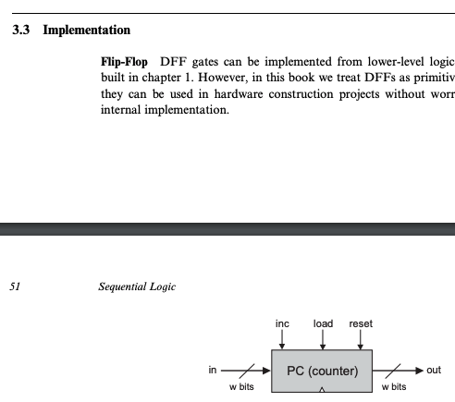
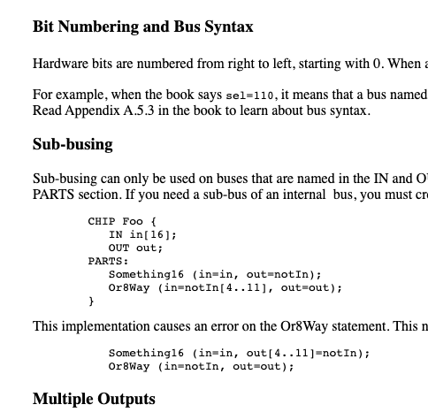
Project 4 Resources
Take advantage of hints in Project 4 readings
Reach out to your classmates and course staff
Post on the Ed discussion board
Come to office hours today after lecture
Chapter 3
HDL Survival Guide

Slide 11
Which of the following statements about assembly languages and machine code is TRUE?
Assembly languages are translated to binary by a compiler
Assembly languages were created to provide a more human-readable format for specifying machine code
Registers are temporary storage locations that are stored in memory
The Hack computer architecture supports multiplication and division
We’re lost…

Slide 12

Revisiting The Von Neumann Architecture
(This picture will get more detailed as we go!)
COMPUTER
MEMORY
CPU
PROGRAM
INPUT
OUTPUT
DATA
REGISTERS
CONTROL

Slide 13
Machine Code
Instructions are stored in memory, so they must be able to be encoded in binary
When we refer to machine code, we are typically talking about this binary representation of code
Each instruction is a sequence of 0s and 1s
Our computer / hardware specification is what gives meaning to each part of this sequence
“Is this an add or subtract instruction? What are the inputs?”

Slide 14
Storing the Program
(This picture will get more detailed as we go!)
COMPUTER
MEMORY
CPU
0
1
2
0101110011100110
1011000101010100
1110001011111100
...
Instructions
INPUT
OUTPUT
n
n+1
n+2
1100101010010101
1100100101100111
0011001010101011
...
Data
REGISTERS
CONTROL

Slide 15
Assembly Languages
Writing code using 0s and 1s is tedious and error prone
Assembly languages are a human-readable format of binary instructions that a CPU runs
Each human-readable assembly instruction has a corresponding binary machine code instruction
Example: addq reg1, reg2 == 0b1011000101010100
Assembly is often used as an intermediary between a high-level programming language and machine code

Slide 16
Producing Machine Code
while (i < 100) {
sum += arr[i];
i++;
}
Java
Compile
MEMORY
CPU
0101110011100110
1011000101010100
1110001011111100
...
Machine Code Instructions
PROGRAM
DATA
Load & Execute
REGISTERS
CONTROL
16

Slide 17
Producing Machine Code
while (i < 100) {
sum += arr[i];
i++;
}
Java
Compile
MEMORY
CPU
0101110011100110
1011000101010100
1110001011111100
...
Machine Code Instructions
PROGRAM
DATA
Load & Execute
REGISTERS
CONTROL
movq $5, %rdx
addq %rsx, %rdx
movq %rdx, %rax
ret
Assembly Language
Assemble
17

Slide 18
Producing Machine Code
while (i < 100) {
sum += arr[i];
i++;
}
Java
Compile
MEMORY
CPU
0101110011100110
1011000101010100
1110001011111100
...
Machine Code Instructions
PROGRAM
Compile
DATA
Load & Execute
REGISTERS
CONTROL
movq $5, %rdx
addq %rsx, %rdx
movq %rdx, %rax
ret
Assembly Language
Assemble
18

Slide 19
Lecture Outline
Annotation Strategies
The What and How of Annotating Texts
Introduction to Assembly Languages
Producing Machine Code
Machine Language Specifications
Operations, Addressing Modes, & Flow Control
The Hack Assembly Language
Registers, A-Instructions, Symbols, & C-Instructions

Slide 20
Machine Language
Specification of the Hardware / Software interface
What operations are supported?
What do they operate on?
How is the program controlled?
Usually in close correspondence with the hardware architecture
Different specification for different hardware platforms
Cost and Performance Tradeoffs
Silicon area and complexity
Time to complete instruction
Power consumption

Slide 21
Machine Operations
Correspond to the operations supported by hardware:
Arithmetic (+, –)
Logical (And, Or)
Flow Control (“go to instruction n”, “if (condition) then go to instruction n”)
Differences between machine languages:
Instruction set richness (e.g., division? bulk copy?)
Data types (e.g., word size, floating point)

Slide 22
Registers
CPU
CPU typically has a small number of registers
Very efficient to access
Used for intermediate, short-term “scratch work”
Number and use of registers is a central part of any machine language
REGISTERS
rsp
0101110011100110
reg2
0101110011100110
D
0101110011100110
CONTROL
22

Slide 23
Addressing Modes
Ways to specify operands or inputs in assembly
Some useful options:
Register
add reg1, reg2
Direct Memory Access
add reg1, Memory[200]
Indirect Memory Access
add reg1, Memory[reg2]
Immediate
add 100, reg2
Register names
Access the giant array (i.e., memory) at index 200

Slide 24
Flow Control
COMPUTER
Which instruction should execute next?
MEMORY
CPU
0
1
2
0101110011100110
1011000101010100
1110001011111100
...
Instructions
INPUT
OUTPUT
n
n+1
n+2
1100101010010101
1100100101100111
0011001010101011
...
Data
REGISTERS
CONTROL
PC
1
24

Slide 25
Flow Control
Usually, the CPU just executes machine instructions in a sequence
Typically moves to the instruction with the next highest address
Sometimes we want to always “jump” to another location
Example: At the end of an infinite loop
High Level Code (similar to Java) | Assembly Code
while (true) { reg1++; <more loop body> } <code after loop> | TOP: add 1, reg1 <more loop body> jmp TOP <code after loop>

Slide 26
Flow Control
Usually, the CPU just executes machine instructions in a sequence
Typically moves to the instruction with the next highest address
Sometimes we want to “jump” only if a condition is met
Example: At the condition of an if statement
High Level Code (similar to Java) | Assembly Code
if (reg1 < reg2) { reg1++; } reg2++; | cmp reg1, reg2 jge SKIP add 1, reg1 SKIP: add 1, reg2

Slide 27
Five-minute Break!
Feel free to stand up, stretch, use the restroom, drink some water, review your notes, or ask questions
We’ll be back at:
Research shows mid-lecture breaks reduce the decline of attention in the middle of lecture (Olmsted, 1999)
Olmsted III, John. “The Mid-Lecture Break: When Less Is More.” Journal of Chemical Education (1999). https://pubs.acs.org/doi/abs/10.1021/ed076p525.

Slide 28
Lecture Outline
Annotation Strategies
The What and How of Annotating Texts
Introduction to Assembly Languages
Producing Machine Code
Machine Language Specifications
Operations, Addressing Modes, & Flow Control
The Hack Assembly Language
Registers, A-Instructions, Symbols, & C-Instructions

Slide 29
The Hack Computer
The hardware you will build
16-bit word size
ROM: sequence of instructions
ROM[0], RAM[1]…
RAM: data sequence
RAM[0], RAM[1]…
COMPUTER
MEMORY
CPU
ROM
(16-bit Instructions, Read-Only)
1110001011111100
REGISTERS
RAM
(16-bit Data,
Read / Write)
1100101010010101
A/M
D
SCREEN
CONTROL
KEYBOARD
PC
29

Slide 30
The Hack Machine Language
Two types of instructions (16-bit)
A-instructions load data
C-instructions perform computations
Program: sequence of instructions
COMPUTER
MEMORY
CPU
ROM
(16-bit Instructions, Read-Only)
1110001011111100
REGISTERS
RAM
(16-bit Data, Read/Write)
1100101010010101
A/M
D
SCREEN
CONTROL
KEYBOARD
PC
30

Slide 31
Hack: Control Flow
Startup
Hack instructions loaded into ROM
Reset signal initializes computer state (instruction 0)
Execution
Usually, advance to next instruction each cycle
On jump instruction, write a different address into the PC
0
1
2
3
4
5
6
7
...
0101110011100110
1011000101010100
1110001011111100
0101110101101110
0001011000111010
0010111011011001
0110111110101001
0001110010110110
ROM (Instructions)

Slide 32
Program Counter (PC)
Keeps track of what instruction we are executing
If the PC outputs 24, on the next clock cycle the computer runs the instruction at address 24 in the code segment
Next cycle, replace counter value with in
(E.g., method calls)
Next cycle, add 1 to counter value
(E.g., normal operation)
Next cycle, set counter to 0
(E.g., program start)
load
inc
reset
in
PC
out
16
16

Slide 33
Hack: Registers
D Register: For storing Data
A Register: For storing data and Addressing memory
M “Register”: The 16-bit word in Memory currently being referenced by the address in A
RAM
1100101010010101
...
106
107
108
109
110
...
REGISTERS
M
A
108
D

Slide 34
Hack: A-Instructions
Syntax:
value can either be:
A non-negative decimal constant
A symbol referring to a constant
Semantics:
Stores value in the A register
@value

Slide 35
Hack: A-Instructions
Symbolic Syntax
Loads a value into the A register
Example:
Binary Syntax
@value
0000000000010101
Family:
A-Instruction
Value:
Binary encoding of 21
A Register
D Register
...
@21
...
0
0
A Register
D Register
21
0

Slide 36
Hack: Symbols
Symbols are simply an alias for some address
Only in the symbolic code—don’t turn into a binary instruction
Assembler converts use of that symbol to its value instead
Example:
LOOP = 02
00
01
02
03
04
@3
D=0
(LOOP)
@21
D=1
@LOOP
...
00
01
02
03
04
0000000000000011
1110101010010000
0000000000010101
1110111111010000
0000000000000010
...
Assemble

Slide 37
Hack: Built-In Symbols
Using ( ) defines a symbol in ROM / Instructions
Assembler knows a few built-in symbols in RAM / Data
R0, R1, ..., R15: Correspond to addresses at the very beginning of RAM (0, 1, …, 15)
“Virtual registers,” Useful to store variables
SCREEN, KBD: Base of I/O Memory Maps
Example:
A Register
D Register
...
@R3
...
0
0
A Register
D Register
3
0

Slide 38
Hack: C-Instructions
Syntax: (dest and jump optional)
dest is a combination of destination registers:
comp is a computation:
jump is an unconditional or conditional jump:
Semantics:
Computes value of comp
Stores results in dest (if specified)
If jump is specified and condition is true (by testing comp result), jump to instruction ROM[A]
dest = comp ; jump
M, D, MD, A, AM, AD, AMD
0, 1, -1, D, A, !D, !A, -D, -A, D+1, A+1, D-1, A-1, D+A, D-A, A-D, D&A, D|A, M, !M, -M, M+1, M-1, D+M, D-M, M-D, D&M, D|M
JGT, JEQ, JGE, JLT, JNE, JLE, JMP

Slide 39
Hack: C-Instructions
Symbolic:
Binary:
dest = comp ; jump
1 1 1 a c1 c2 c3 c4 c5 c6 d1 d2 d3 j1 j2 j3
Family:
C-Instruction
Unused
Comp:
ALU Operation (a bit chooses between A and M)
Dest:
Where to store result
Jump:
Condition for jumping

Slide 40
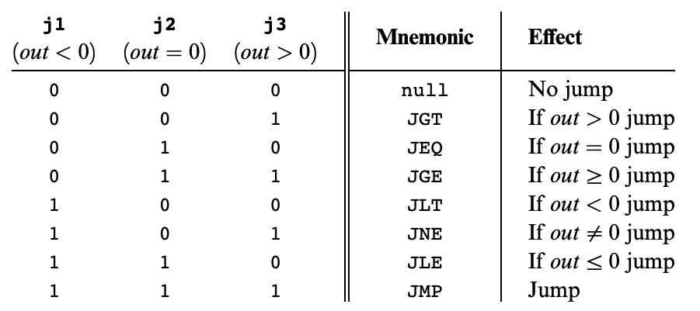
Hack: C-Instructions
Symbolic:
Binary:
dest = comp ; jump
1 1 1 a c1 c2 c3 c4 c5 c6 d1 d2 d3 j1 j2 j3
Jump:
Condition for jumping
Chapter 4

Slide 41
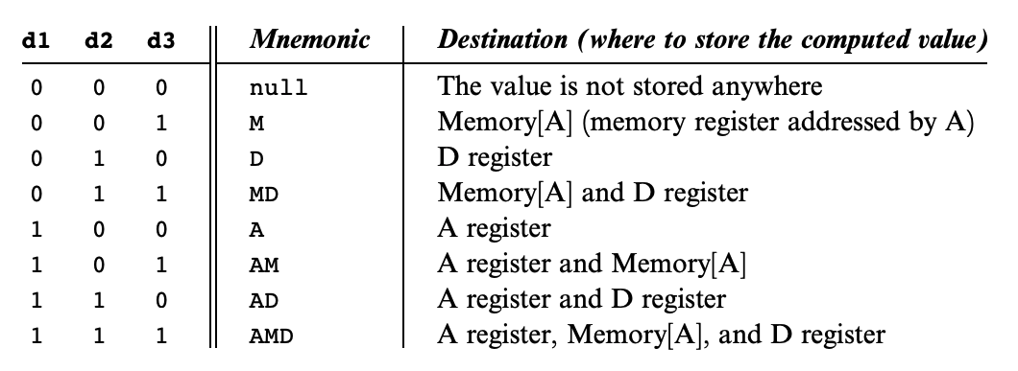
Hack: C-Instructions
Symbolic:
Binary:
dest = comp ; jump
1 1 1 a c1 c2 c3 c4 c5 c6 d1 d2 d3 j1 j2 j3
Dest:
Where to store result
Chapter 4

Slide 42
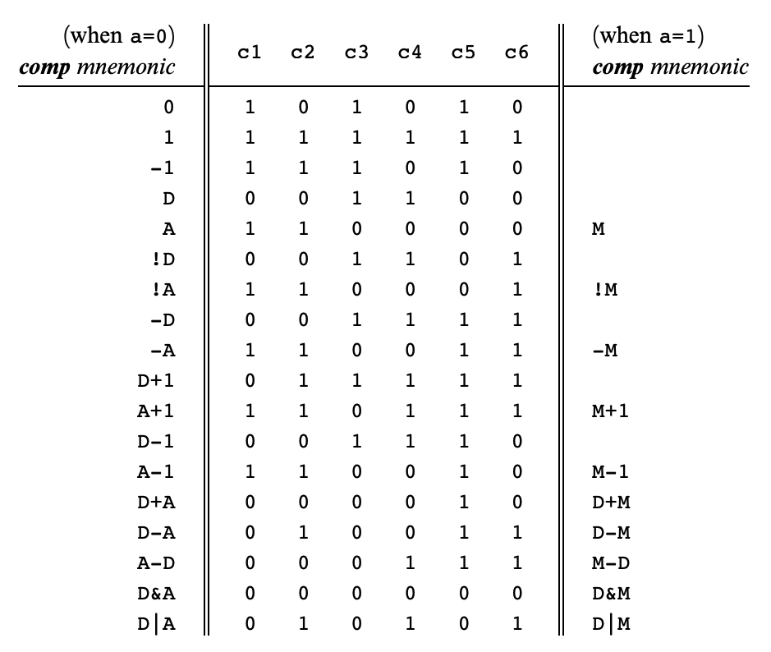
Hack: C-Instructions
Symbolic:
Binary:
dest = comp ; jump
1 1 1 a c1 c2 c3 c4 c5 c6 d1 d2 d3 j1 j2 j3
Comp:
ALU Operation (a bit chooses between A and M)
Chapter 4
Important: just pattern matching text!
Cannot have “1+M”

Slide 43
Hack: C-Instructions Example
A Register
D Register
55
56
00
01
(EXAMPLE)
@55
D=A+1

Slide 44
Hack: C-Instructions Example
A Register
D Register
55
56
00
01
02
03
(EXAMPLE)
@55
D=A+1
@R2
M=D
RAM
0
?
A Register
D Register
1
?
2
56
2
56
...

Slide 45
Hack: C-Instructions Example
A Register
D Register
55
56
00
01
02
03
04
05
(EXAMPLE)
@55
D=A+1
@R2
M=D
@EXAMPLE
D;JGT
RAM
0
?
A Register
D Register
1
?
2
56
2
56
...
A Register
D Register
0
56
(Will jump to instruction 0, since D > 0)

Slide 46
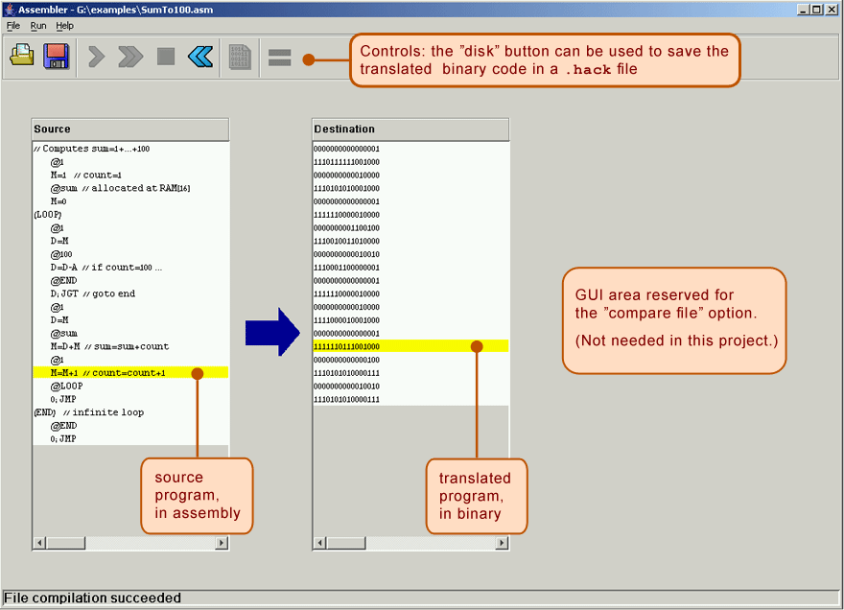
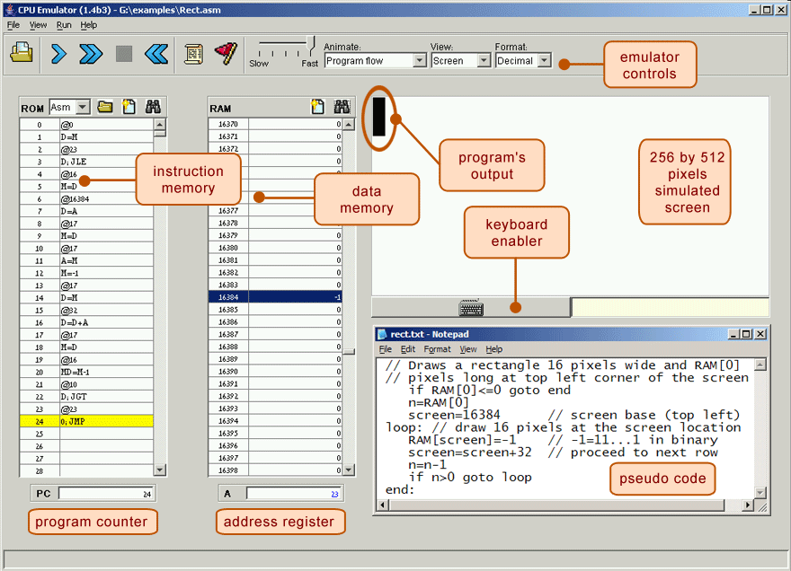
Project 5: Tools
The test scripts use the .hack files directly! Don’t let your .asm and .hack get out of sync!
Running a Test Script (recommended flow):
Quickly Iterating or Experimenting:
Max.asm
Max.hack
Assembler
CPUEmulator
Max.asm
CPUEmulator
Can still “run” the program, even without a script

Slide 47
Tools Exercise: Run SimpleAdd.tst
In GitLab, a projects/lecture/ folder was added with a SimpleAdd.asm example
Open the assembly file SimpleAdd.asm. What does this program do?
Assemble SimpleAdd.asm using the Assembler to produce SimpleAdd.hack
Run SimpleAdd.tst using the CPUEmulator and verify there are no errors

Slide 48
Lecture 7 Wrap-up
Project Reminders
Project 3 grades released by Thursday (feedback on Gradescope)
Project 4 due Thursday (4/21) at 11:59pm PDT
Project Scores and Late Days are updated weekly and can be viewed on Canvas under “Assignments”
Lecture 8 Reading: Final Memory Chip

